Slide 1
Tools for sustainable tourism
Lecture 8

Slide 2
USING SYSTEMS THINKING & Intervention
Points
Review the lecture on systems thinking
Review the Intervention points
Apply these as Tools for Sustainable tourism

Slide 3
Four different types of intervention points
Parameters
Feedbacks
Design-Based
Intent Based

Slide 4




Simplest but least effective
12. Constants, parameters, numbers (such as subsidies, taxes, standards).
11. The sizes of buffers and other stabilizing stocks, relative to their flows.
10. The structure of material stocks and flows (e.g. transport networks,
population age structures).
9. The lengths of delays, relative to the rate of system change.
8. The strength of negative feedback loops, relative to the impacts they
are trying to correct against.
7. The gain around driving positive feedback loops.
6. The structure of information flows (who does/doesn’t have access to info)
5. The rules of the system (such as incentives, punishments, constraints).
4. The power to add, change, evolve, or self-organize system structure.
3. The goals of the system.
2. The mindset or paradigm out of which the system — its goals, structure,
rules, delays, parameters — arises.
1. The power to transcend paradigms.
Most effective but very hard

Slide 5

PARAMETERS

Slide 6
PARAMETERS
Arguably the most common tool used in tourism
Effectiveness vs ease of development/implementation
Relies heavily on indicators &
Most often on linear approaches (one problem at a time)
Some examples:
  Constants, parameters, numbers (such as subsidies, taxes, standards).
  The sizes of buffers and other stabilizing stocks, relative to their flows (e.g. zoning in national parks)
  The structure of material stocks and flows (e.g. transport networks).

Slide 7
Difficulty with parameters for sustainable tourism
Most sites are unique
Impacts may result from many activities, not just tourism
Time lag between cause & effect
Little consensus on which indicators are most appropriate to indicate change
Remember the wicked problem issue

Slide 8
A range of impact measurement tools for parameter-based interventions
Visitor Impact Management (VIM)
Visitor Experience and Resource Protection (VERP)
Visitor Activity Management Process (VAMP)
Recreation Opportunity Spectrum (ROS)
Tourism Optimisation Management Model (TOMM)
As well Environmental Impact Assessment tools

Slide 9
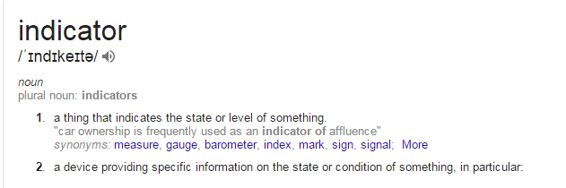
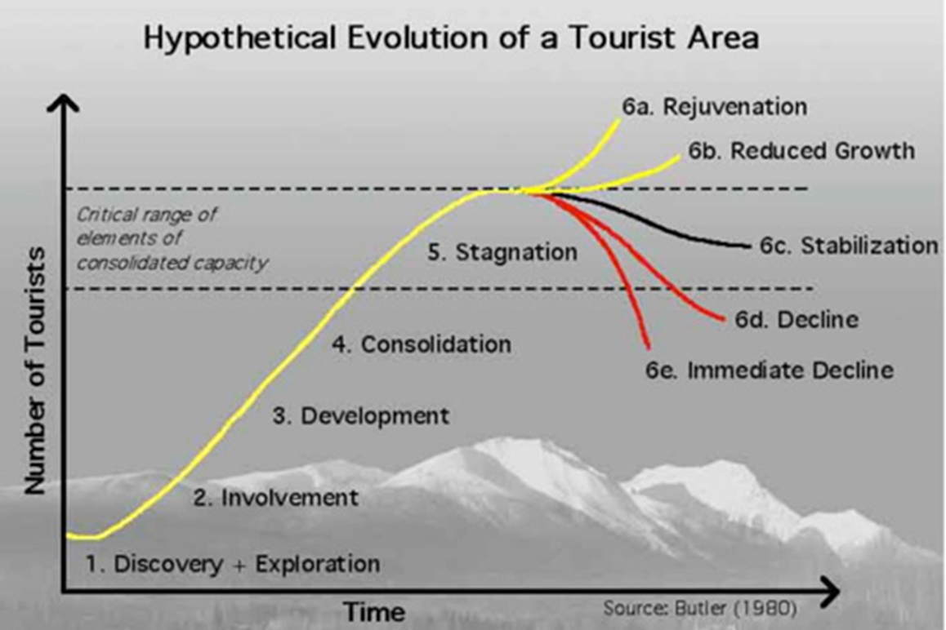
INDICATORS
Indicators are variables providing information about the status of some phenomenon
What is the question that we want to answer using an indicator, and will the indicator answer that question?
Does the selected indicator demonstrate a direct relationship with the natural, social, or economic status of tourism?
Can the indicator be measured easily and relatively inexpensively, i.e. will it be worth collecting?
Will the indicator trigger action before the conditions have deteriorated to an unacceptable level?

Slide 10
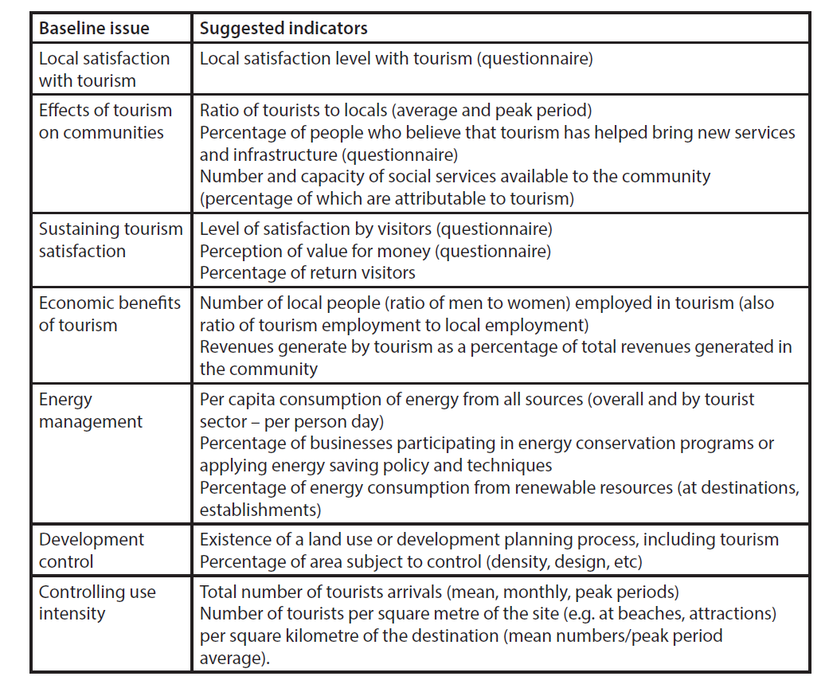
Some indicators suggested for Sustainable Tourism

Slide 11
Challenges of indicators
fuzzy boundaries of complex tourism systems
incompatible timeframes of monitoring vs. political process
nonlinear relationships between cause & effect
lack of knowledge regarding benchmarks & thresholds
potential incompatibility between environmental, economic & sociocultural outcomes

Slide 12
Limits of acceptable change
Moves away from linear thinking.
Recognises a complex system, and that change is INEVITABLE
so instead… 9 step systematic process

Slide 13
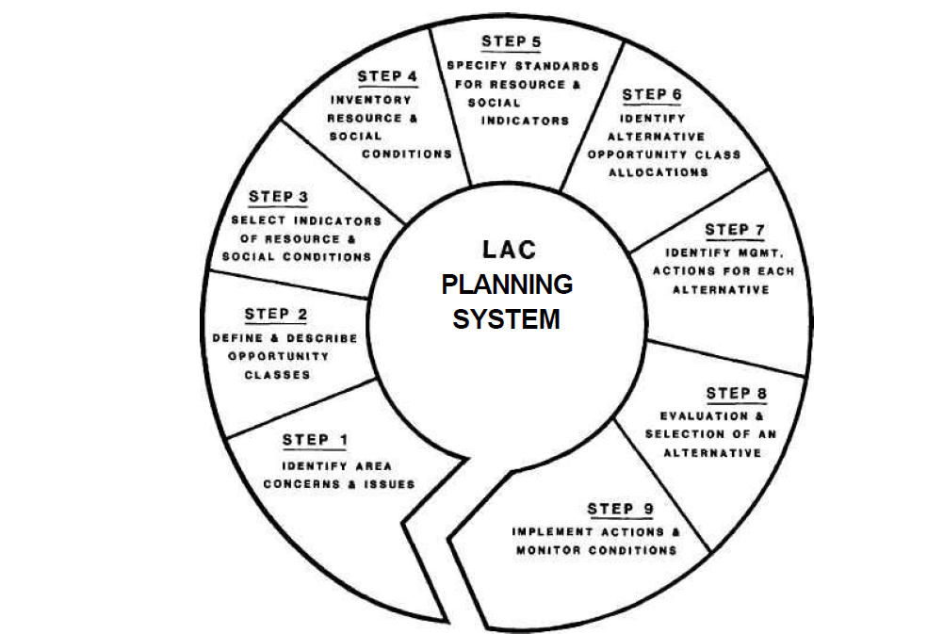
9 steps of LAC process
1. Identity areas’ special values, issues & concerns
2. Identify & describe recreation opportunity classes
3. Select indicators of resource and social conditions
4. Inventory existing resource and social conditions
5. Specify standards for resources and social conditions in each opportunity class
6. Identify alternative opportunity class allocations
7. Identify management actions for each alternative
8. Evaluate and select preferred alternative
9. Implement actions and monitor conditions.

Slide 14
Feedback-based

Slide 15
Feedback interventions
Less common in tourism, because requires a more holistic approach
Can take several forms:
  Shortening length of delays
  Strengthening negative/balancing feedback loops
  Strengthening positive virtuous loops

Slide 16
Shorten length of delays
Links to the archetype of the tragedy of the commons which is a big issue in sustainable tourism
Smart tech which provides instant feedback (e.g. water usage in a shower, length of queues/traffic at an attraction, etc.)
Also tools like carbon calculators, to see carbon footprint before travelling

Slide 17
Strengthening negative feedback loops
A negative feedback loop is one that keeps the system balanced, i.e. in a given state, so best used early on!
Find feedback relationships which can stabilise the system
e.g. new some of the new policies to manage Airbnb rentals -> the aim is to stop the switching of housing stock from rentals to short-term holidays lets, so use economic penalties for switching.

Slide 18
Strengthening positive feedback loops
A positive feedback loop is one that will move the system to a new state, so can repair a system that has already has negative impacts
Find feedback relationships which can move the system to a desirable state
e.g. switching livelihoods from poaching to ecotourism and putting the benefits back into the community, e.g. Masai conservancy models

Slide 19


Slide 20
Design-based

Slide 21
Design-based
More holistic again, and requiring greater collaboration and vision setting (see Lecture 7)
Can use three different approaches:
    The structure of information flows (who does/doesn’t have access to info)
    The rules of the system (such as incentives, punishments, constraints).
    The power to add, change, evolve, or self-organize system structure.

Slide 22
The rules of the system
Governance processes, e.g. ESG
Permits (e.g. entry permits, professional competencies)
Prizes and awards
Marketing and demarketing activities
ALterna

Slide 23

Demarketing: selective vs general

Slide 24
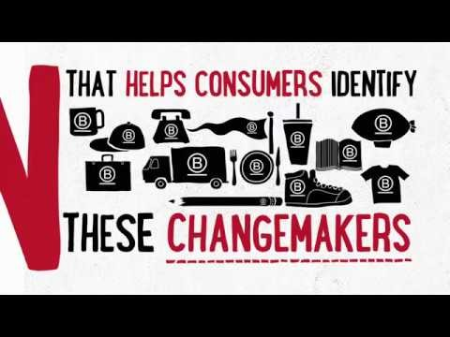

Slide 25
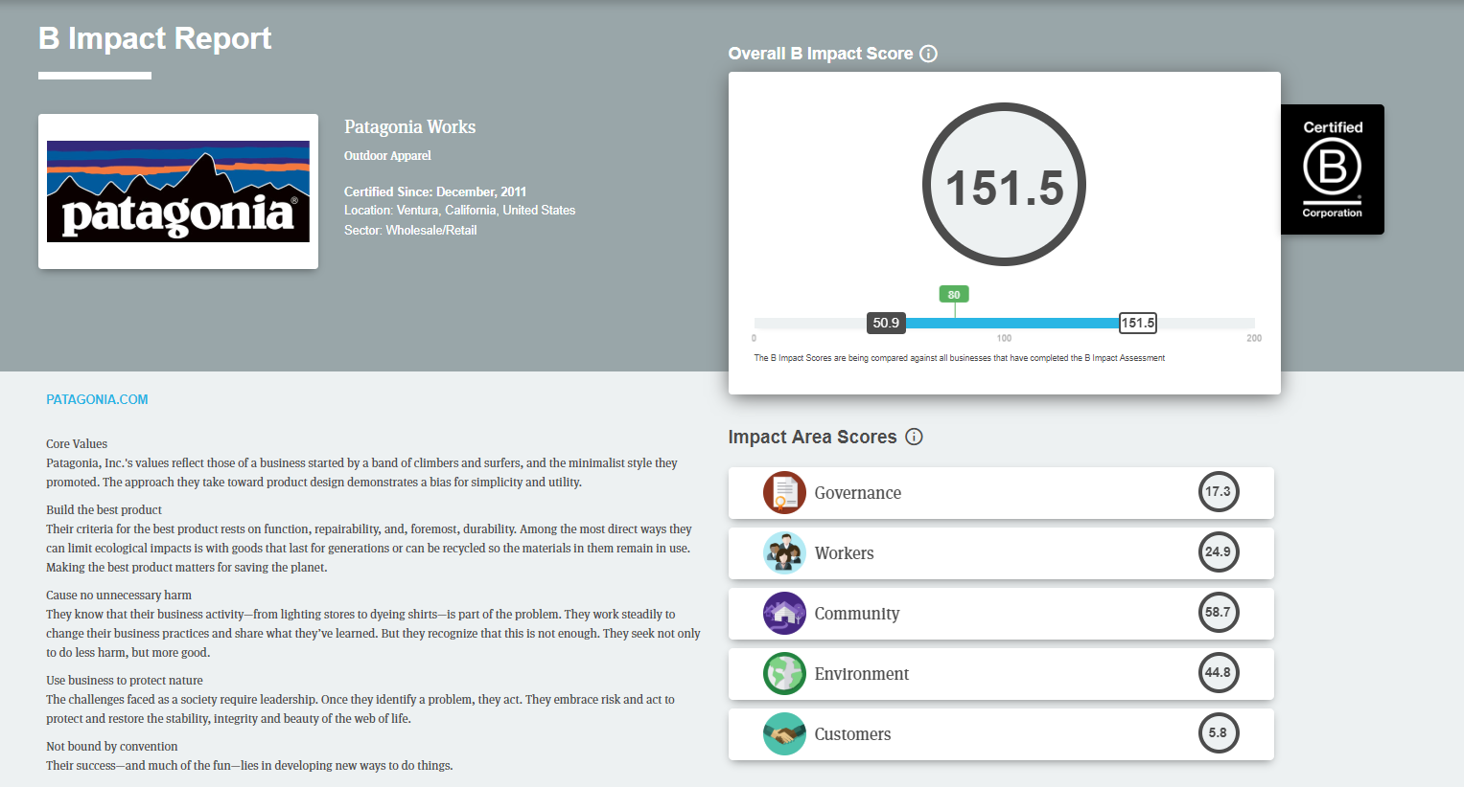
PATAGONIA – B Corp.

Slide 26
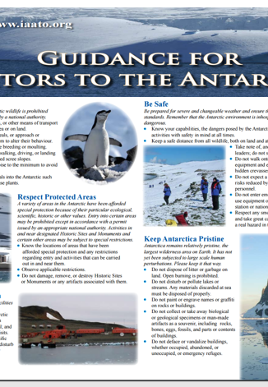
Codes of practice
Negatives:
- voluntaryno timelines
voluntary
vague, general
self-regulated
Positives:

Slide 27
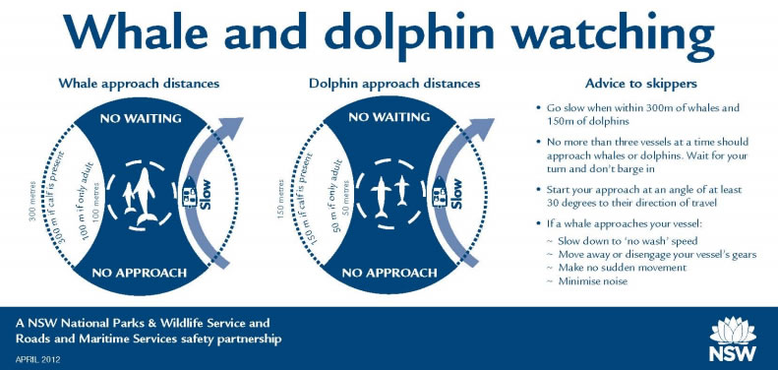
Whale watching code for boats

Slide 28

Ecolabels operate on the supply side of sustainable tourism and are understood to establish business compliance with external standards of positive environmental performance
Widely available over the last 30 years, 47 different schemes exist but only adopted by 1% of tourism businesses.
They are seen to serve three general purposes:
1. Standardise desirable environmental performance levels across the sector,
2. Ensure certified businesses understand and meet those performance levels
3. Serve as competitive point of difference for a market looking for green products.

Slide 29

Ecolabels: pros and cons
Low implementation costs, when compared to government regulations.
Cost savings from operating more efficiently.
Marketing advantages for the environmentally-conscious tourism market
Credibility through the third party auditing system.
The cost of implementation, as businesses sign up to the certification program and must complete the paperwork associated with the environmental performance (and change their practices in some cases).
The low level of consumer awareness of labels, reducing any marketing advantage.
The variability in quality and issue of credibility between programs
The lack of a measure of the effectiveness of ecolabels
The issue of inequality in developing countries.

Slide 30
Intent-based

Slide 31
Intent-based
Requires resetting the whole way of thinking and what we are striving for
Can use two (main) approaches:
  The goals of the system.
  The mindset or paradigm out of which the system — its goals, structure, rules, delays, parameters - arises
The third item under intent-based sits on the edge of what is known, e.g. is this all just a simulation?

Slide 32
The goals of the system
All the alternative economic models
But be careful around the notion of growth
Regenerative tourism (see Lecture 11)

Slide 33
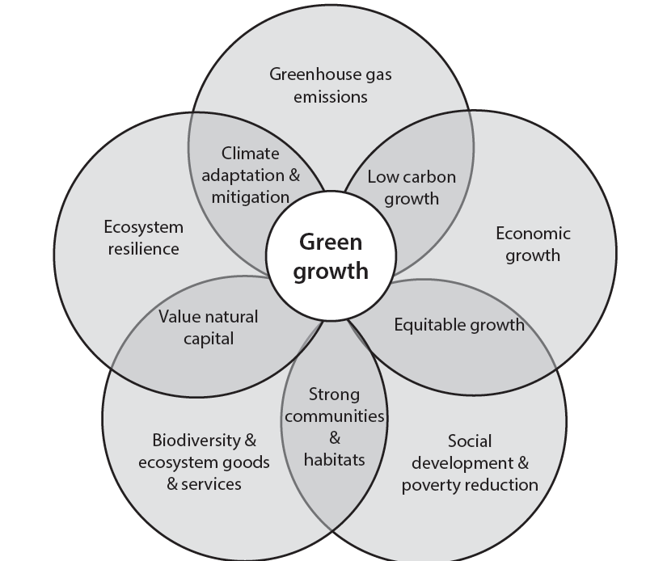
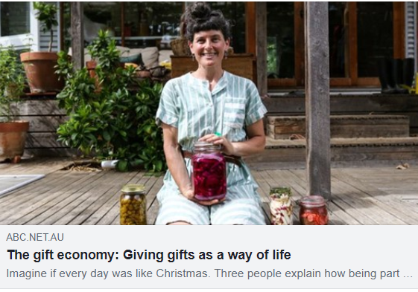
Alternative economic models
Circular economy
Green economy
Shared economy
Gift economy

Slide 34
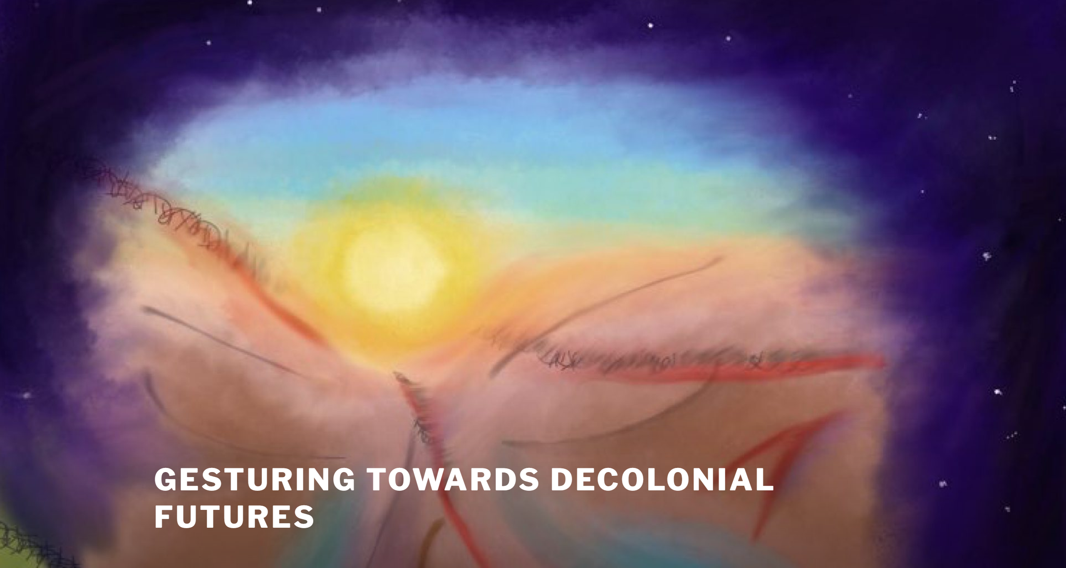
The paradigm guiding the system
One changing “paradigm” in tourism is the push towards focussing on hosts rather than tourists – i.e. visitation is determined by host happiness
A deeper paradigm change would be something like decolonial thinking, e.g. the collective Gesturing Towards Decolonial Futures

Slide 35
Deep paradigm changes
Questioning all assumptions, e.g. growth, lack/not enough for everyone/competition, progress and development, etc.
Re-evaluating the role of the expert/science, vs local, felt knowledge
Big questions of consciousness, connection, etc.
Showing up in a big way around questions of Artificial Intelligence.

Slide 36

The third approach is mind-bending
The third approach gets into a whole new world, e.g. Donald Hoffman and co on whether all of this is a simulation!
(c.f. his TED talk, if you
really want to
push boundaries)

Slide 37
Next up…
How do you operationalise (some of) this?

